Slide 1
Hierarchical Clustering
Clustering is the assignment of data objects (records) into groups (called clusters) so that data objects from the same cluster are more similar to each other than objects from different clusters .
The Hierarchical method works by grouping data objects(records) into a tree of clusters.
Uses distance(similarity) matrix as clustering criteria. We provide a termination condition
Classified Further as
    Agglomerative Hierarchical Clustering
    Divisive Hierarchical Clustering

Slide 2
Agglomerative Hierarchical Clustering
Data objects are grouped in a bottom-up fashion.
Initially each data object is in its own cluster.
Then merge these atomic clusters into larger and larger clusters, until all of the objects are in a single cluster or until certain termination conditions are satisfied.
Termination condition can be specified by the user, as the desired number of clusters.

Slide 3
Divisive Hierarchical Clustering
In this data objects are grouped in a top down manner
Initially all objects are in one cluster
Then the cluster is subdivided into smaller and smaller pieces, until each object forms a cluster on its own or until it satisfies certain termination conditions as the desired number of clusters is obtained.

Slide 4
AGNES and DIANA
(AGglomerative NESting) (DIvisive ANAlysis)
Agglomerative and divisive hierarchical clustering on data objects {a, b, c, d ,e }
Step 0
Step 1
Step 2
Step 3
Step 4
agglomerative
(AGNES)
a
a b
b
a b c d e
c
c d e
d
d e
e
divisive
(DIANA)
Step 4
Step 3
Step 2
Step 1
Step 0

Slide 5
AGNES-Algorithm
Given a set of N objects to be clustered, and an N*N distance (or similarity) matrix, the basic process of hierarchical clustering (defined by S.C. Johnson in 1967) is this:
Start by assigning each object to a cluster, so that for N objects, we have N clusters, each containing just one object. Let the distances (similarities) between the clusters the same as the distances (similarities) between the objects they contain.
Find the closest (most similar) pair of clusters and merge them into a single cluster, so that now we have one cluster less.
Compute distances (similarities) between the new cluster and each of the old clusters.
Repeat steps 3 and 4 until all items are clustered into a single cluster of size N.

Slide 6
… Continue
Step 4 can be done in different ways, and this distinguishes single-linkage, complete linkage and average-linkage clustering
For Single Linkage: distance between one cluster and another cluster is equal to the shortest distance from any member of one cluster to any member of the other cluster
For Complete Linkage: distance between one cluster and another cluster to be equal to the greatest distance from any member of one cluster to any member of the other cluster.

Slide 7
Single Linkage Hierarchical Clustering Example
Initially “Every point is its own cluster”

Slide 8
Single Linkage Example
“Every point is its own cluster”
Find “most similar(distance)” pair of clusters

Slide 9
Single Linkage Hierarchical Clustering Example…
“Every point is its own cluster”
Find “most similar” pair of clusters
Merge it into a parent cluster

Slide 10
… CONT
“Every point is its own cluster”
Find “most similar” pair of clusters
Merge it into a parent cluster
Repeat

Slide 11
Showing Below How a Hierarchical Tree is Formed

Slide 12
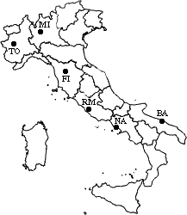
Example 2 :A hierarchical clustering of distances in kilometers between some Italian cities. The method used is single-linkage.
 | BA | FI | MI | NA | RM | TO
BA | 0 | 662 | 877 | 255 | 412 | 996
FI | 662 | 0 | 295 | 468 | 268 | 400
MI | 877 | 295 | 0 | 754 | 564 | 138
NA | 255 | 468 | 754 | 0 | 219 | 869
RM | 412 | 268 | 564 | 219 | 0 | 669
TO | 996 | 400 | 138 | 869 | 669 | 0

Slide 13
Procedure
The nearest pair of cities is MI and TO, at distance 138. These are merged into a single cluster called "MI/TO". The level of the new cluster is L(MI/TO) = 138 and the new sequence number is m = 1.
Then we compute the distance from this new compound object to all other objects. In single link clustering the rule is that the distance from the compound object to another object is equal to the shortest distance from any member of the cluster to the outside object. So the distance from "MI/TO" to RM is chosen to be 564, which is the distance from MI to RM, and so on.

Slide 14
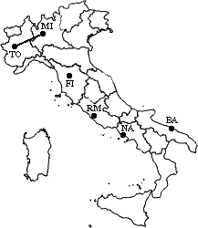
Step-1, Input Distance Matrix L=0 for all clusters
 | BA | FI | MI/TO | NA | RM
BA | 0 | 662 | 877 | 255 | 412
FI | 662 | 0 | 295 | 468 | 268
MI/TO | 877 | 295 | 0 | 754 | 564
NA | 255 | 468 | 754 | 0 | 219
RM | 412 | 268 | 564 | 219 | 0

Slide 15
Step-2,
min d(i,j) = d(NA,RM) = 219 => merge NA and RM into a new cluster called NA/RM
L(NA/RM) = 219
m = 2
 | BA | FI | MI/TO | NA/RM
BA | 0 | 662 | 877 | 255
FI | 662 | 0 | 295 | 268
MI/TO | 877 | 295 | 0 | 564
NA/RM | 255 | 268 | 564 | 0

Slide 16
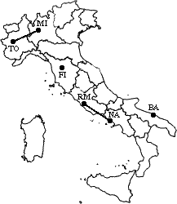
min d(i,j) = d(BA,NA/RM) = 255 => merge BA and NA/RM into a new cluster called BA/NA/RM
L(BA/NA/RM) = 255 m = 3
 | BA/NA/RM | FI | MI/TO
BA/NA/RM | 0 | 268 | 564
FI | 268 | 0 | 295
MI/TO | 564 | 295 | 0

Slide 17
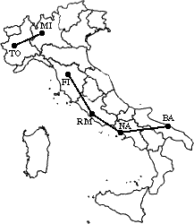
min d(i,j) = d(BA/NA/RM,FI) = 268 => merge BA/NA/RM and FI into a new cluster called BA/FI/NA/RM
L(BA/FI/NA/RM) = 268 m = 4
 | BA/FI/NA/RM | MI/TO
BA/FI/NA/RM | 0 | 295
MI/TO | 295 | 0

Slide 18
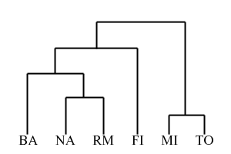
Finally, we merge the last two clusters at level 295.
The process is summarized by the following hierarchical tree:

Slide 19
Advantages:
Is simple and outputs a hierarchy, a structure that is more informative
It does not require us to pre-specify the number of clusters
Disadvantages:
Selection of merge or split points is critical as once a group of objects is merged or split, it will operate on the newly generated clusters and will not undo what was done previously.
Thus merge or split decisions if not well chosen may lead to low-quality clusters

